Slide 1


Survey of Network Interfaces Form (SNIF)
IHE ITI White Paper
Public Comment Introduction
13 March, 2020
Steve Nichols
GE Healthcare

Slide 2





Connectivity in IHE
Registry
Connecting medical devices for communication is challenging!
Each standard has its own connectivity parameters
How do new systems join the environment?
Admitting
Gateway
HL7
FHIR
EMR
web services
RIS
PACS
DICOM
??
Audit Trail
syslog

Slide 3


Interface Staffing
Healthcare Delivery Organizations (HDOs) hire consultants or temporary interface analysts
Resources are spent
Collecting connectivity details
Configuring products
Testing connectivity
After implementation, teams are disbanded
Knowledge is lost
Notes:
Virtual team assembled
Healthcare facility Analyst
Vendor
System owner(s)
Analyst collects connectivity details
New and existing systems are manually configured and tested
Errors are resolved
Team disbanded
Where are the connectivity details?

Slide 4
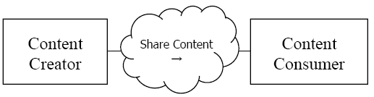
IHE Survey of Network Interfaces Form (SNIF)
Target Endpoints: HL7v2, XD*, DICOM and FHIR
Goal: Standardize catalog, search & retrieval of technical connectivity content
Approach: Available standards and previous approaches to managing configurations Current and Desired State Use Cases Profile proposal with Actors, Transactions and a SNIF content data model
Notes:
Not plug and play
Costs are not well documented, but overhead is
Available standards and previous approaches to configuration management

Slide 5
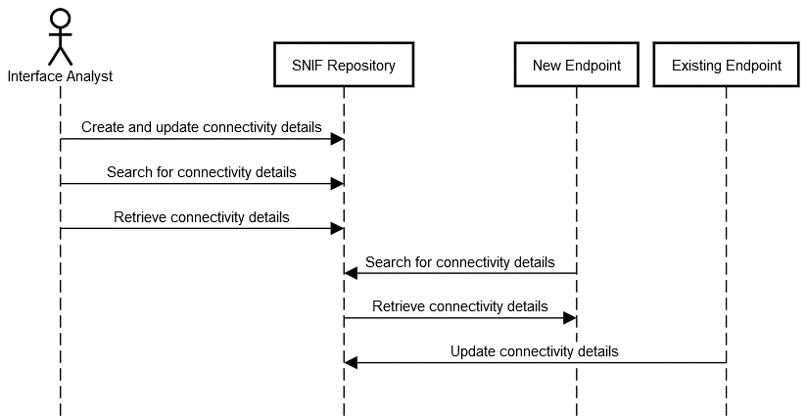
Process Flow
Use cases
Implementation
Service
Create and update connectivity details
Searchable
Machine readable
Secure
Low overhead

Slide 6
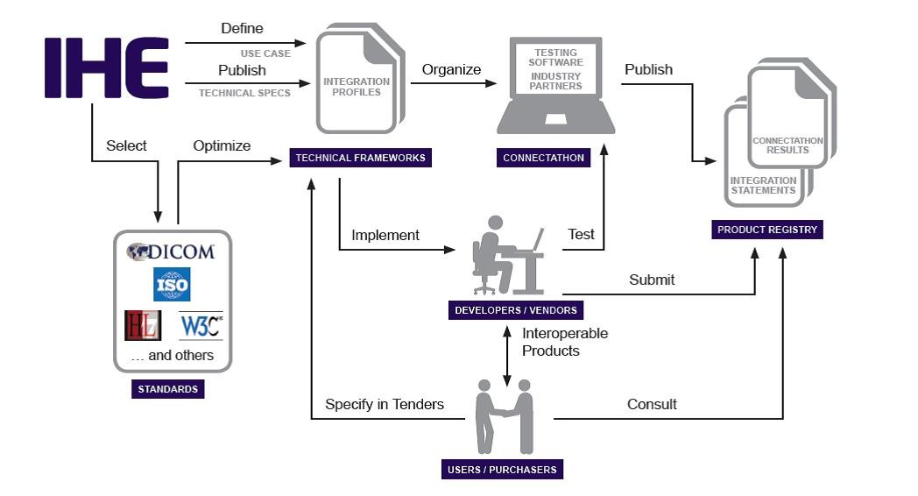
Why a White Paper?
Confirm assumptions:
What is the current approach to endpoint catalogues?
How to standardize?
Would it be adopted?
Technical approach:
Standards for profiling
Data model
Security
Transactions
Public comment needed!

Slide 7
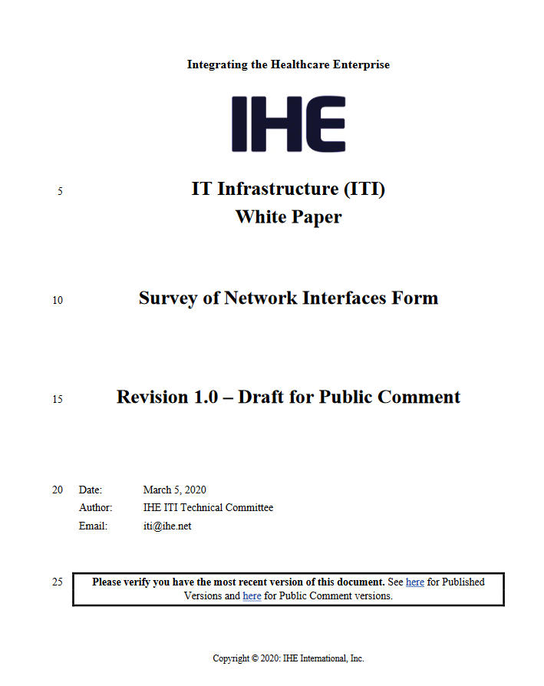
IHE ITI SNIF White Paper
Public Comment: March 5 through April 4 2020 https://www.ihe.net/resources/public_comment/#IT

